Slide 1

GEETANJALI COLLEGE OF ENGINEERING AND TECHNOLOGY(Autonomous)
Cheeryal(v),Keesara(M),Medchal-Malkajgiri(dist).,Telangana-501301
DEPARTMENT OF COMPUTER SCIENCE AND ENGINEERING(AI&ML)
Under the guidance of SK.AKBAR
(Associate professor)
Presentation by: M Rajendar
(23R11A66P4)

Slide 2


Slide 3
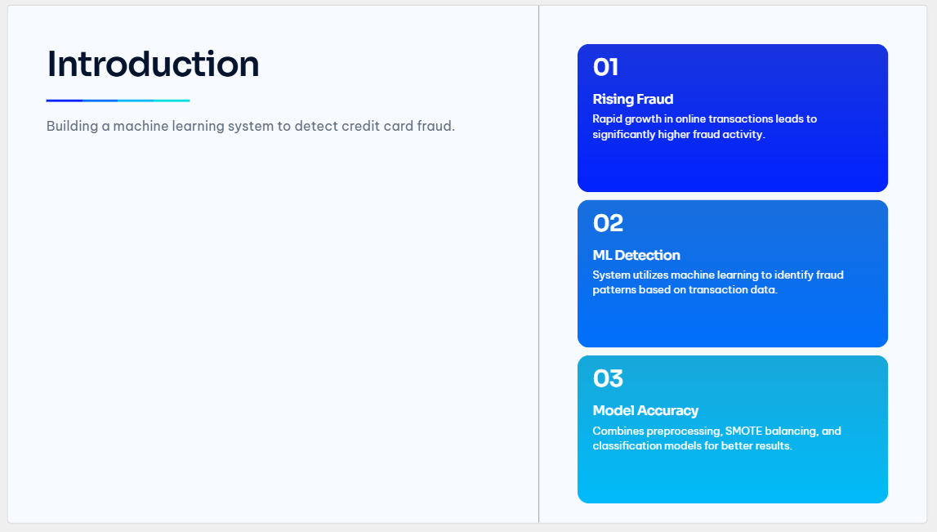


Slide 4
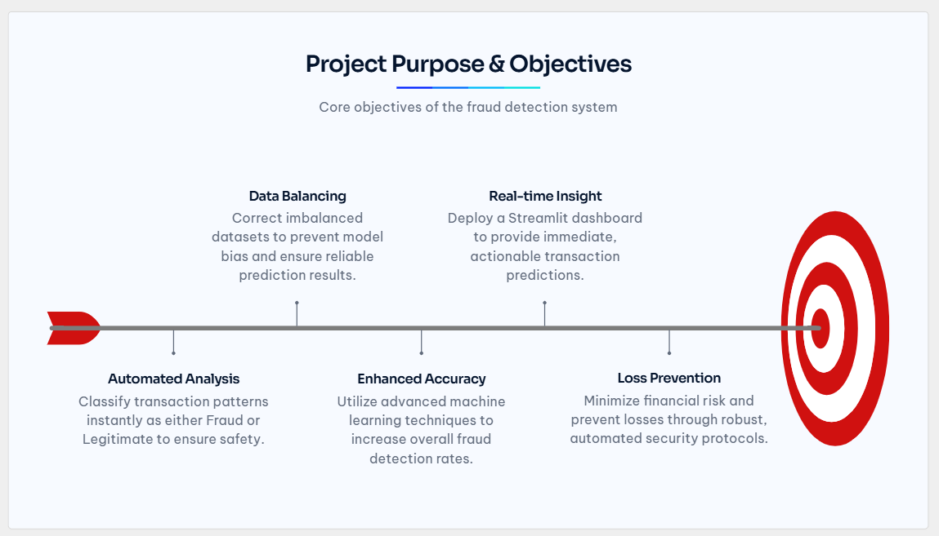

Slide 5
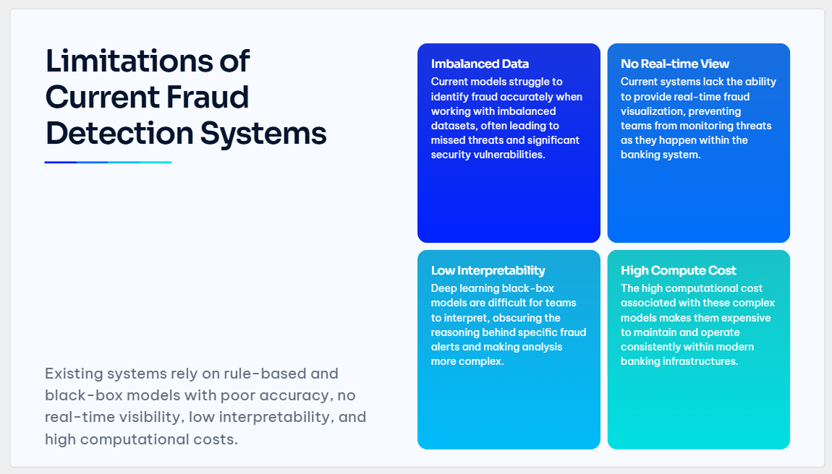

Slide 6
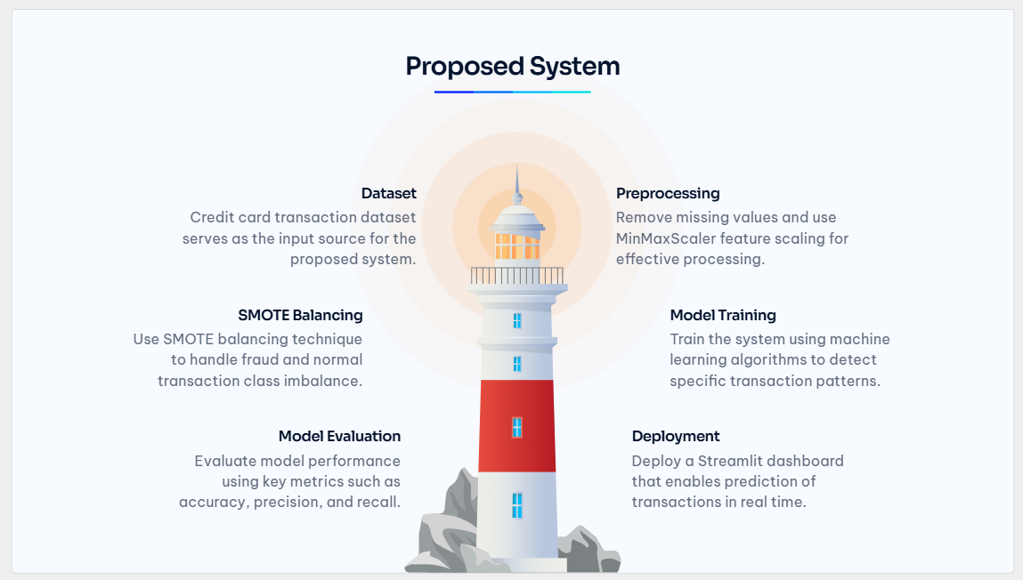

Slide 7
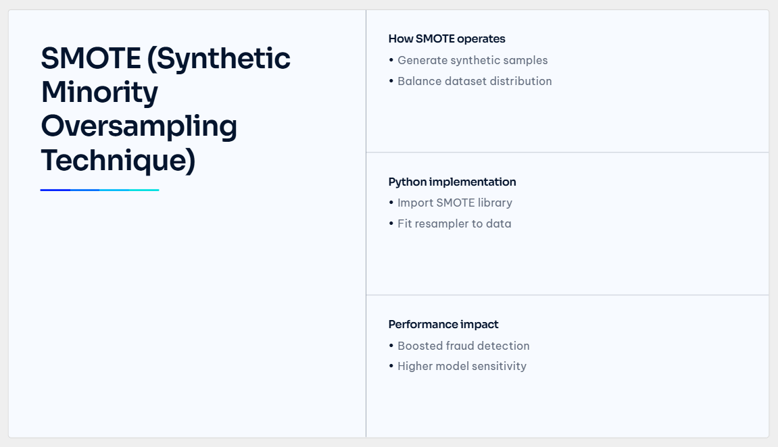

Slide 8
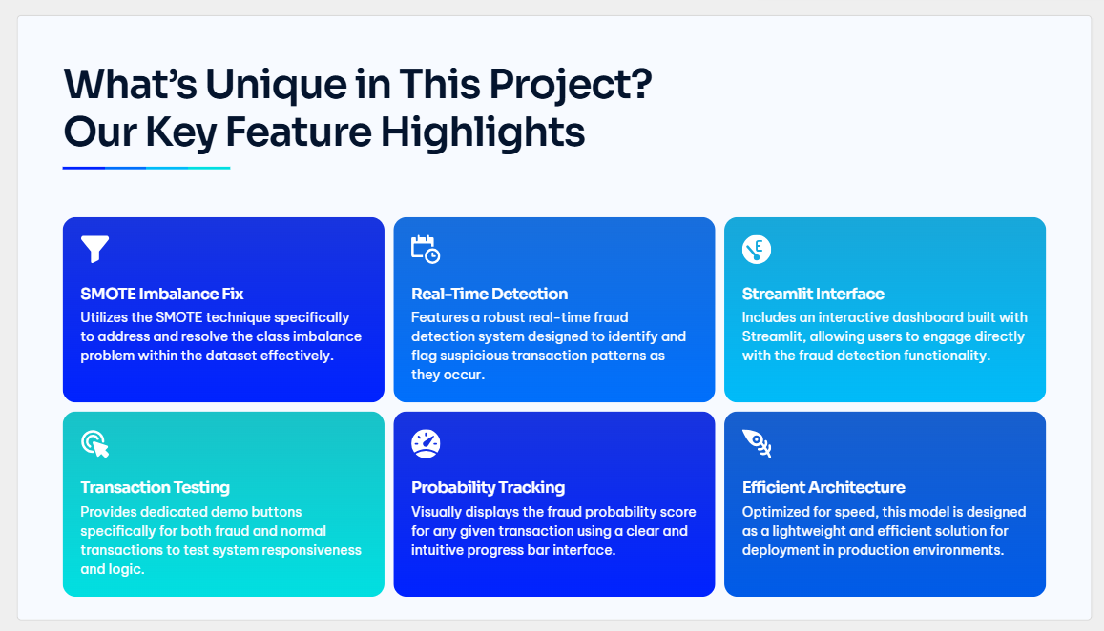

Slide 9
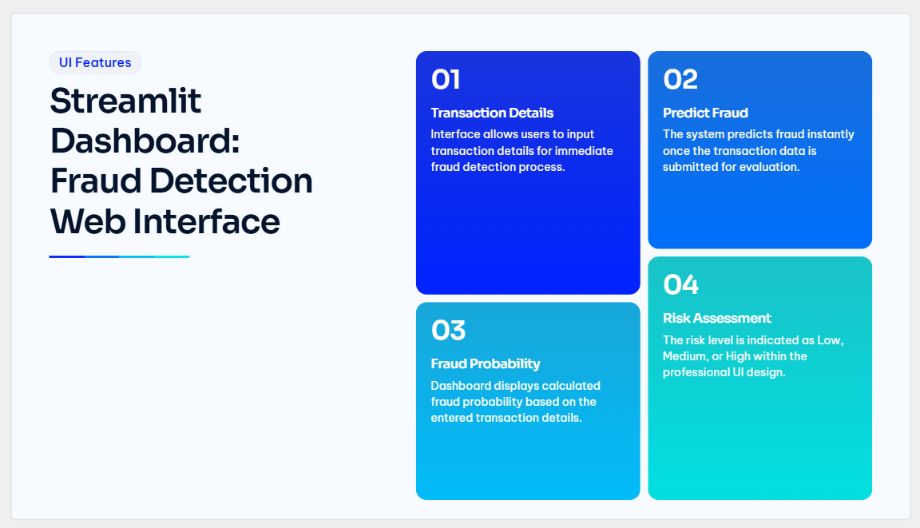

Slide 10
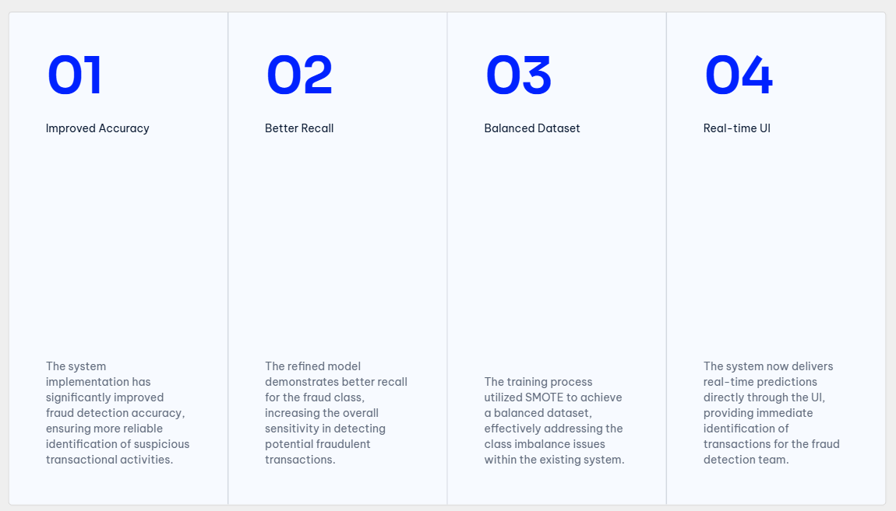

Slide 11
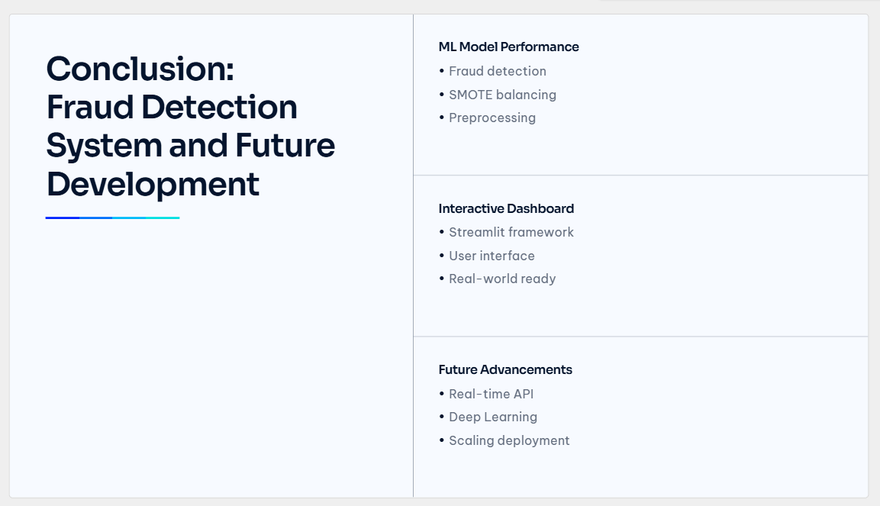

Slide 12


